Slide 1
Artmaking & Storytelling
Artist Kara Elizabeth

Slide 2
vocabulary
Visual Literacy- The ability to interpret, negotiate, and make meaning from information presented in the form of an image.
Infer- Deduce or conclude (information) from evidence and reasoning rather than from explicit statements.
Storytelling- The process of using fact and narrative to communicate something to your audience.
Painting- the process or art of painting with oils, acrylics or watercolors.
Paper collage- A technique of an art production where the artwork is created using an assemblage of different forms and shapes using paper. These forms and shapes eventually create a whole image.
Conceptual Art- Art in which the idea presented by the artist is considered more important than the finished product, if there is one.

Slide 3
Series #1
Artist: Kara Elizabeth
Titles: Blurred Vision, Walking in Darkness, Lost, Shadow Self
Medium: Oil on Canvas
Year: 2007
This series was inspired by my early teenage years, ages 13-15.
Lesson #1: Growth Mindset
“Don’t downgrade your dreams to match your reality. Upgrade your belief to match your vision.”

Slide 4
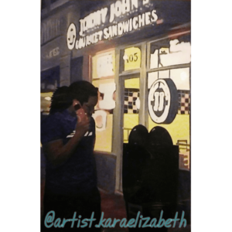
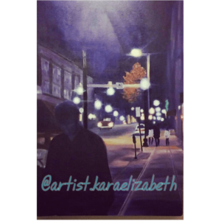
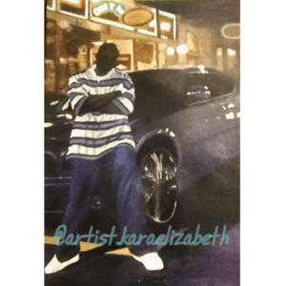
Series #1

Slide 5
series #1: Story time!

Slide 6
Series #2
Artist: Kara Elizabeth
Title: Essence
Medium: Watercolor on Paper
Year: 2017
This series was inspired by my daughter’s struggle with self-worth and identity.
Lesson #2: Honor Your Authentic Self
The chances of being alive right now and walking on this planet is about 1 and 400 trillion. It is literally a miracle to be YOU.

Slide 7
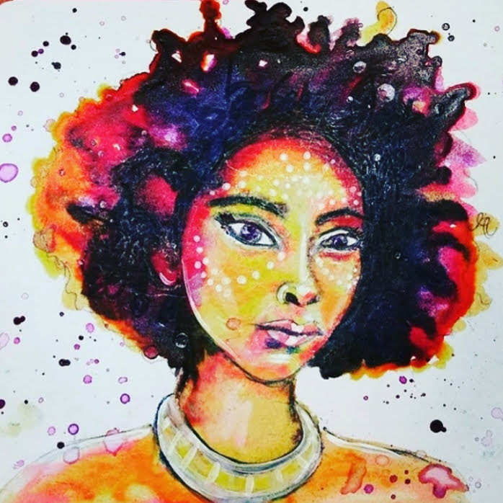
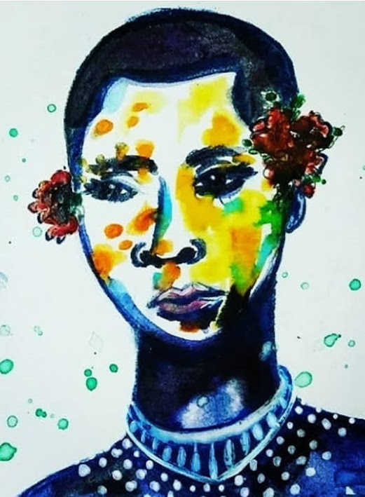
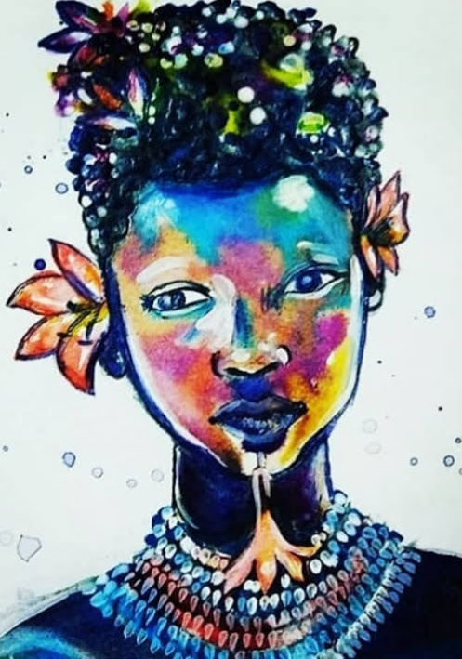
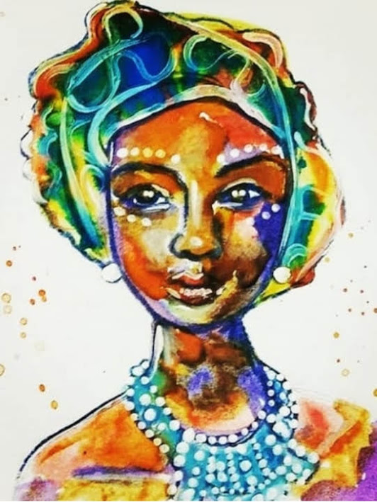
Series #2
KARAELIZABETH
KARAELIZABETH
KARAELIZABETH
KARAELIZABETH

Slide 8
series #2: Story time!

Slide 9
Series #3
Artist: Kara Elizabeth
Title: South Africa
Medium: Ripped-Paper on Canvas
Year: 2018-2019
This series was inspired by my travels to South Africa, summer of 2015 & 2017.
Lesson #3: Choose Joy
As young people, you don’t have any choice about the family you get, where you live, or how much money you have. But you do have a choice about how you show up in the world.

Slide 10
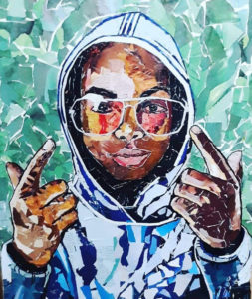
Series #3
KARAELIZABETH
KARAELIZABETH

Slide 11
series #3: Story time!

Slide 12
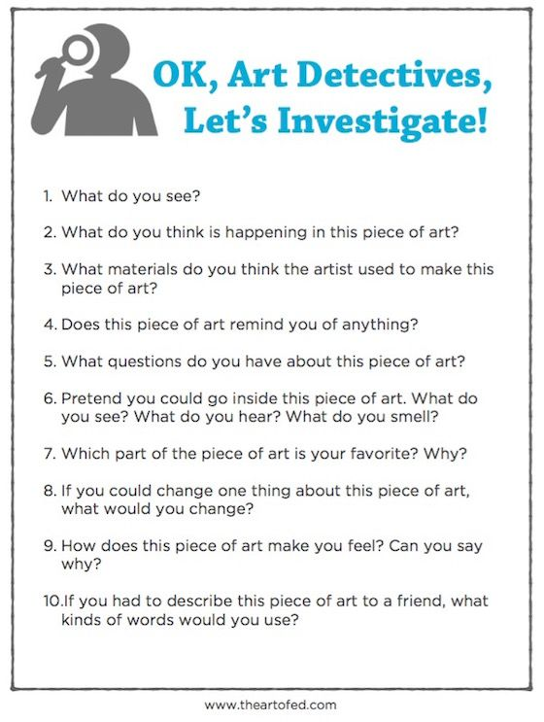
Which artwork is your favorite? Choose one and answer these questions…

Slide 13
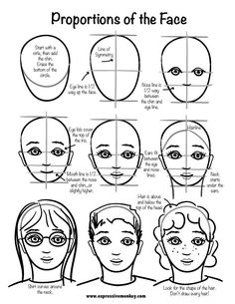
Now it’s Your turn! Draw a portrait of someone who made a significant (positive or negative) impact in your life.

Slide 14
storytelling: Journal the story connected to your drawing. Be sure to answer the following questions. 1. location: inside or outside? What is around you? are other people there? 2. senses: What do you see? what do you hear? What can you smell? 3. Emotions: How do you feel? What are you thinking? Are you happy, sad, scared, lonely, embarrassed, excited? 4. Impact: positive or negative? What happened next? How did this affect you? 5. Lesson: What lesson can you take away from this experience? How will this lesson influence how you treat others? How you treat yourself?

Slide 15
Collaboration Share your story with someone! include details, emotional impact, and the lesson(s) that you learned. What is the moral of your story? How can this story inspire or empower others?

Slide 16
Multiple intelligences
Visual:
View Artwork
Auditory:
Listen to Stories
Intrapersonal: Recall Experiences and Emotions
Kinesthetic:
Draw a Portrait
Interpersonal: Journal about Interactions

Slide 17
standards
RI 3.1 Answer questions to demonstrate understanding
RI.3.6 Distinguish their own point of view from that of the narrator or those of the characters
W.3.3 Write a narrative to develop real experiences or events
3.V.1.2 Understand that artists use their art to express personal ideas
3.V.2.2 Use personal point of view and experiences as sources for creating art
3.CX. 2.2 Understand how to use information learned in other disciplines in visual art
3.CR.1.2 Evaluate the compositional qualities of personal works of art

