Slide 1
Online Teaching
By: Mr. Figuracion

Slide 2
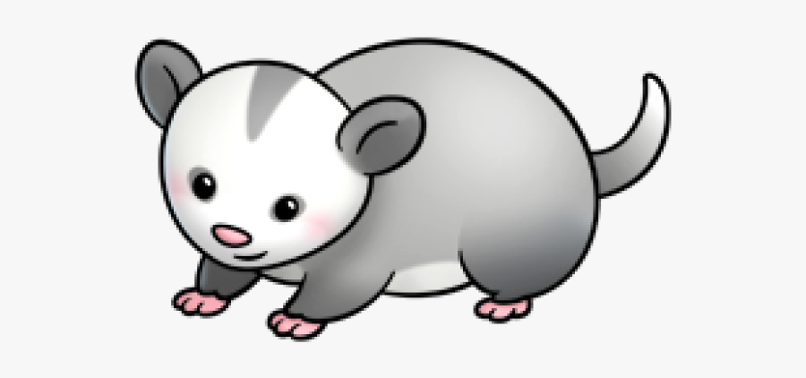
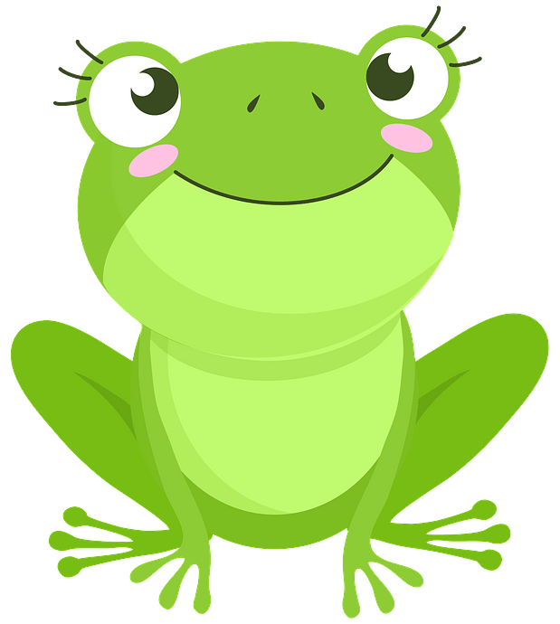
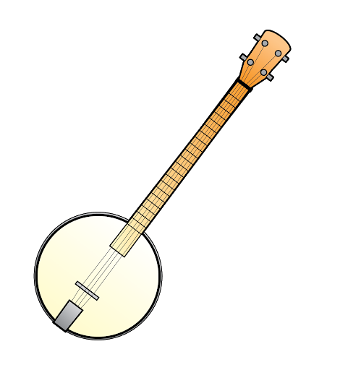
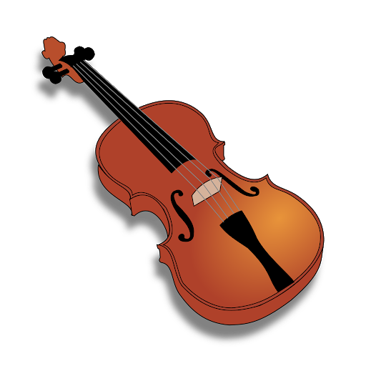
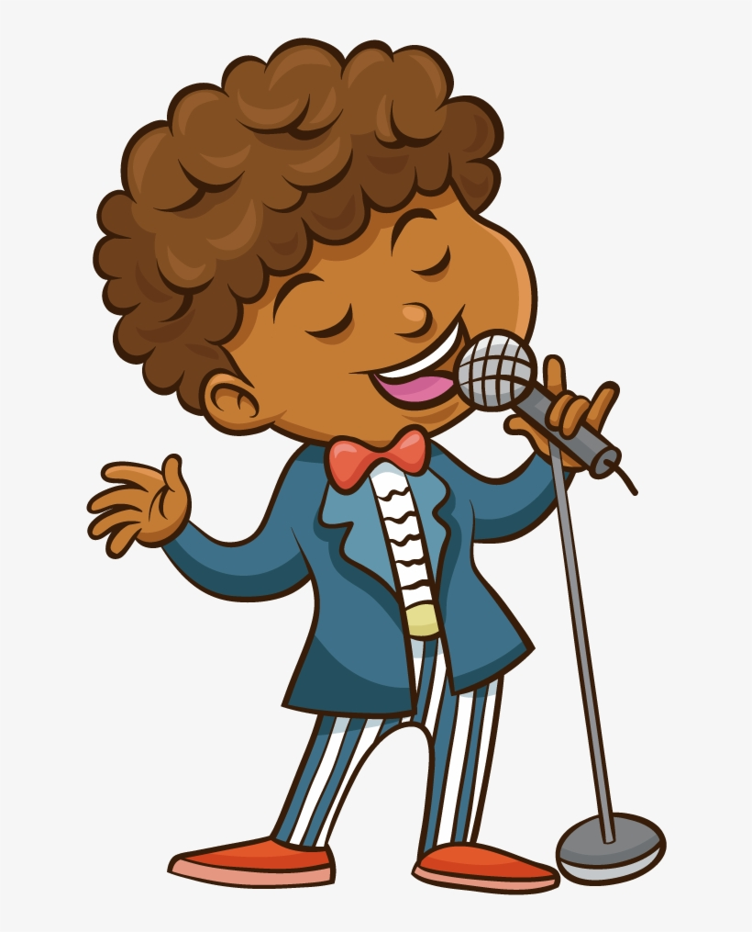
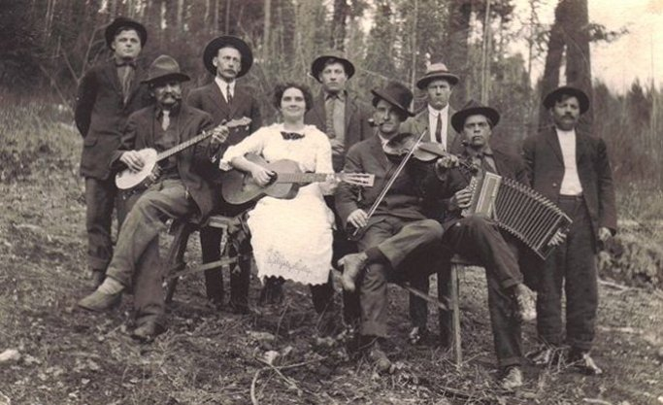
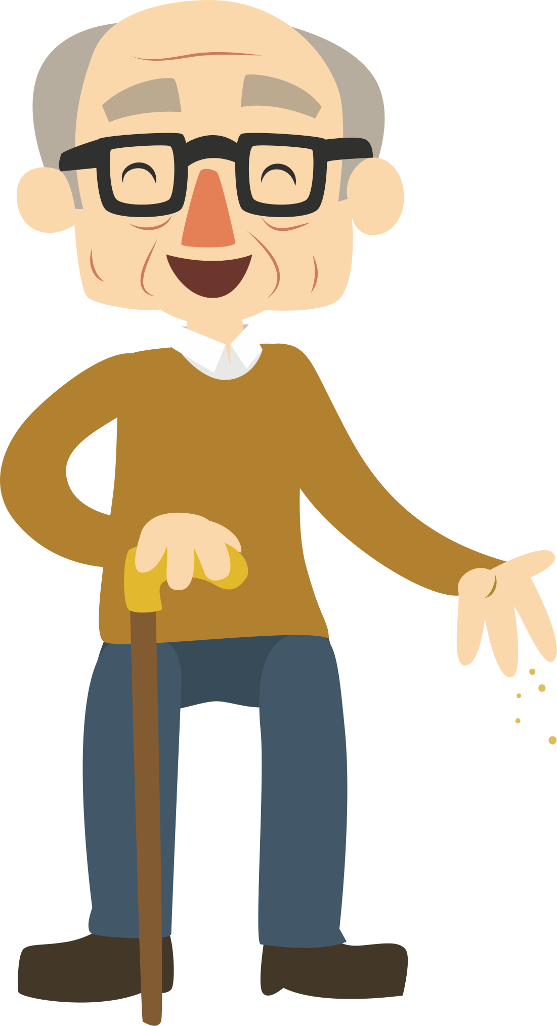
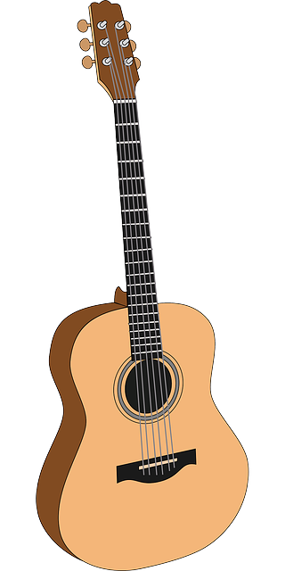
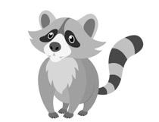
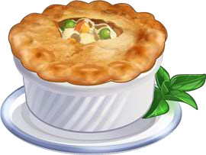
How to use this PowerPoint
Click on Pictures like these

Slide 3
Old Time Music

Slide 4
Sounds of Instruments Listen to each instrument

Slide 5
Sounds of Instruments

Slide 6
Sounds of Instruments

Slide 7
Sounds of Instruments

Slide 8
Bile ‘em Cabbage Down

Slide 9
Bile ‘em Cabbage Down
Click Picture to Hear Again!!!
Bile ‘em Cabbage Down, now
Turn them corncakes ‘round
The only song that I can sing is
Bile ‘em Cabbage Down

Slide 10
Bile ‘em Cabbage Down
Raccoons, they got bushy tails
Possum's tails are bare
Rabbits they got hardly any tail
Just a little tuft of hair

Slide 11
Which parts of the song are repeated? Sing Along with Me!

Slide 12
Almost! Go back and try again

Slide 13
Great Job!
Chorus
Verse

Slide 14
Another Verse
Possum is a cunnin’ thing He travels in the dark And never thinks to curl his tail Till he hears Rover bark

Slide 15
What is Form?

Slide 16
Making the Form: What Order Do You Hear These Parts?

Slide 17
Almost! Go back and try again

Slide 18
Making the Form
1

Slide 19
Almost! Go back and try again

Slide 20
Making the Form
1
2

Slide 21
Almost! Go back and try again

Slide 22
Making the Form
1
2
3

Slide 23
Almost! Go back and try again

Slide 24
Making the Form
1
2
3
4

Slide 25
Almost! Go back and try again

Slide 26
Great Job! You figured out the form
1
2
3
4
5

Slide 27
Sing Along with Me!

Slide 28
Making Your Own Form

Slide 29
Making Your Own Form

Slide 30
Old Joe Clark

Slide 31
Old Joe Clark
Old Joe Clark he had a house Fifteen stories high Every story in that house Was filled with chicken pie

Slide 32
Old Joe Clark
Fare ye well, Old Joe Clark Fare ye well, I say Fare ye well, Old Joe Clark I'm a going away

Slide 33
Which parts of the song is the Chorus? (Remember our earlier slides!!!)

Slide 34
Almost! Go back and try again

Slide 35
Great Job!
Chorus
Verse

Slide 36
Another Verse
Old Joe Clark he was a frog, could jump a mile high. Put him on a trampoline, He bounced up to the sky.

Slide 37
Same of Different?
SAME?
Different?

Slide 38
Almost! Go back and try again

Slide 39
Great Job! It is the same form
1
2
3
4
5
1
2
3
4
5

Slide 40
Let’s Sing Together!

Slide 41
Thank You! Stay Safe Everyone!

