Slide 1
ROMARE BEARDEN
Li’L Dan the Drummer Boy, A Civil War Story
by Romare Bearden

Slide 2
A Message from Mrs. Reid, Arts Integration Facilitator, Visual Arts specialist

Slide 3
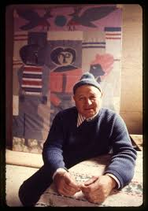
Romare Bearden
Romare Bearden was a famous African-American artist.
He was born in 1911 in Charlotte, North Carolina and he died in 1988 in New York City, New York.
He grew up in Harlem, a neighborhood in New York City where many African-American artists lived and worked during a time called the Harlem Renaissance.
During the Harlem Renaissance visual artists, musicians, actors, and authors were very busy doing new things in each of their fields.
Bearden was a painter and a musician, but he is best known for his collages.

Slide 4
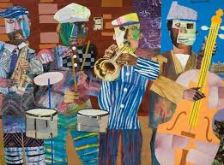
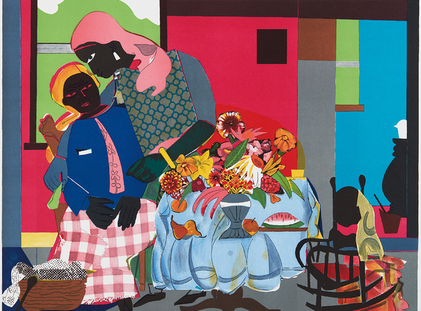
COLLAGES
Jazz Village (1967)
Bearden’s collages are lively, colorful and full of the life he observed around him.
His style is uniquely different and very personal.
Musicians making music, the party atmosphere, dancers, lots of people, repeated colors and shapes: all these things make his artwork a celebration of his life.
He was one of the first artists to make collage a serious art form.
His work is extensive—meaning he made a lot of it.
Morning (1979)

Slide 5
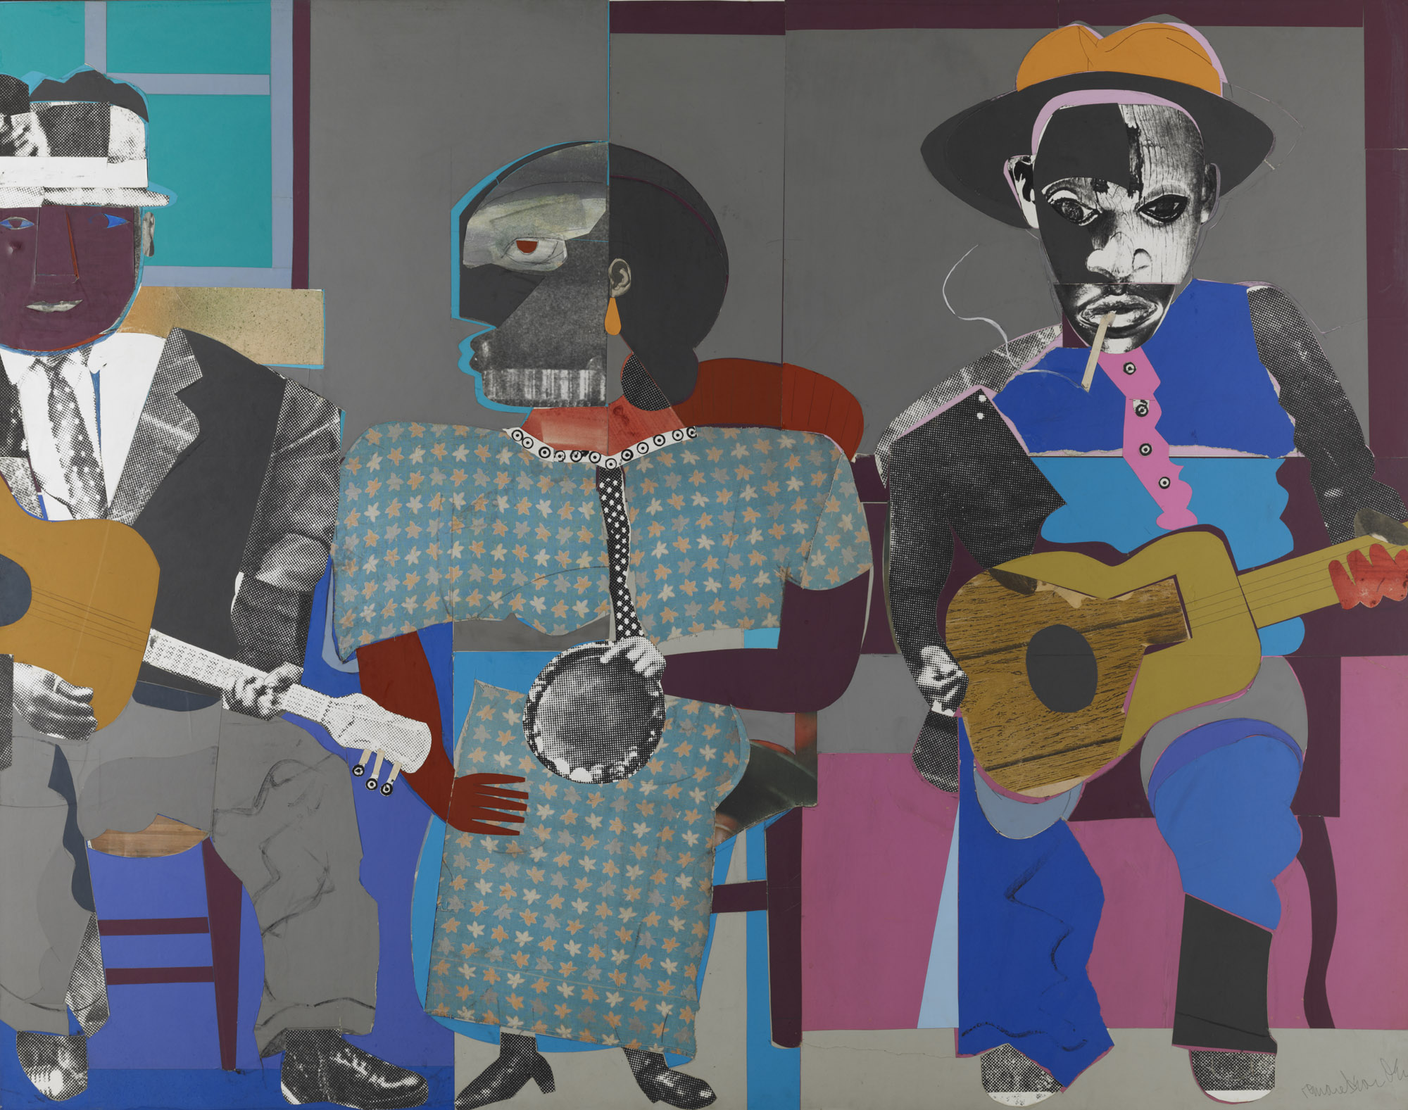
SOME examples of Romare Bearden’s ART
Three Folk Musicians (1967), collage painting.
Virginia Museum of Fine Arts
Soul Three (1968), paper and fabric collage on board.
Dallas Museum of Art

Slide 6
The Block (1971), cut and pasted printed, colored and metallic papers, photostats, graphite, ink marker, gouache, watercolor, and ink on Masonite.
Metropolitan Museum of Art

Slide 7
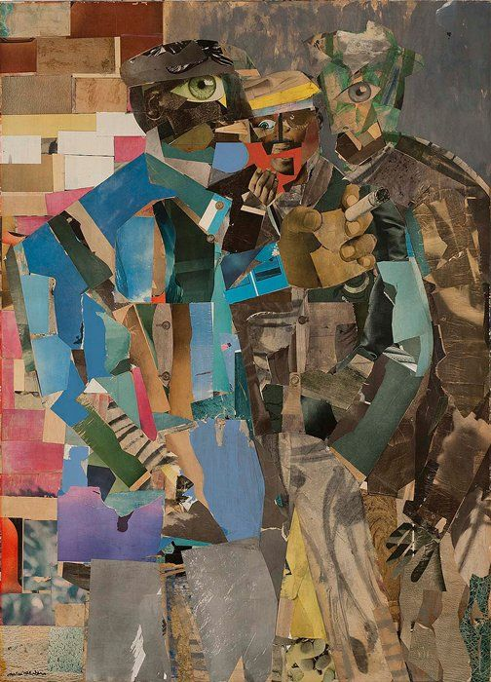
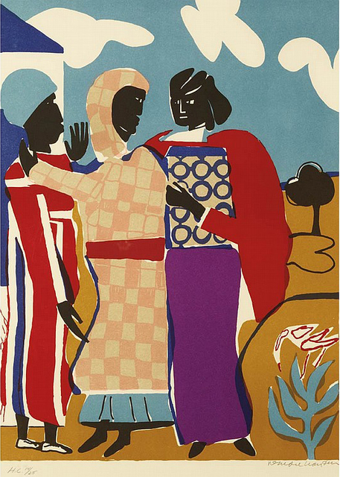
Three Women (Easter Sunday) (1979), lithograph in colors. Hofstra University Museum.
Three Men (1966-1967), collage.
San Francisco Museum of Modern Art

Slide 8
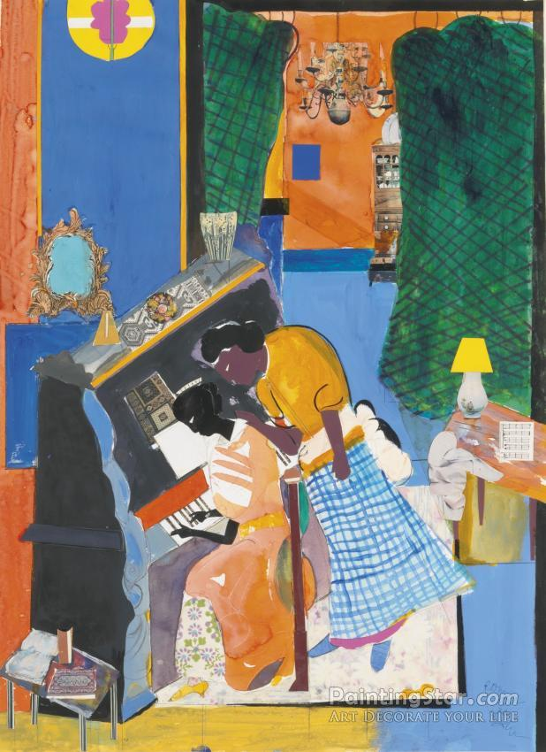
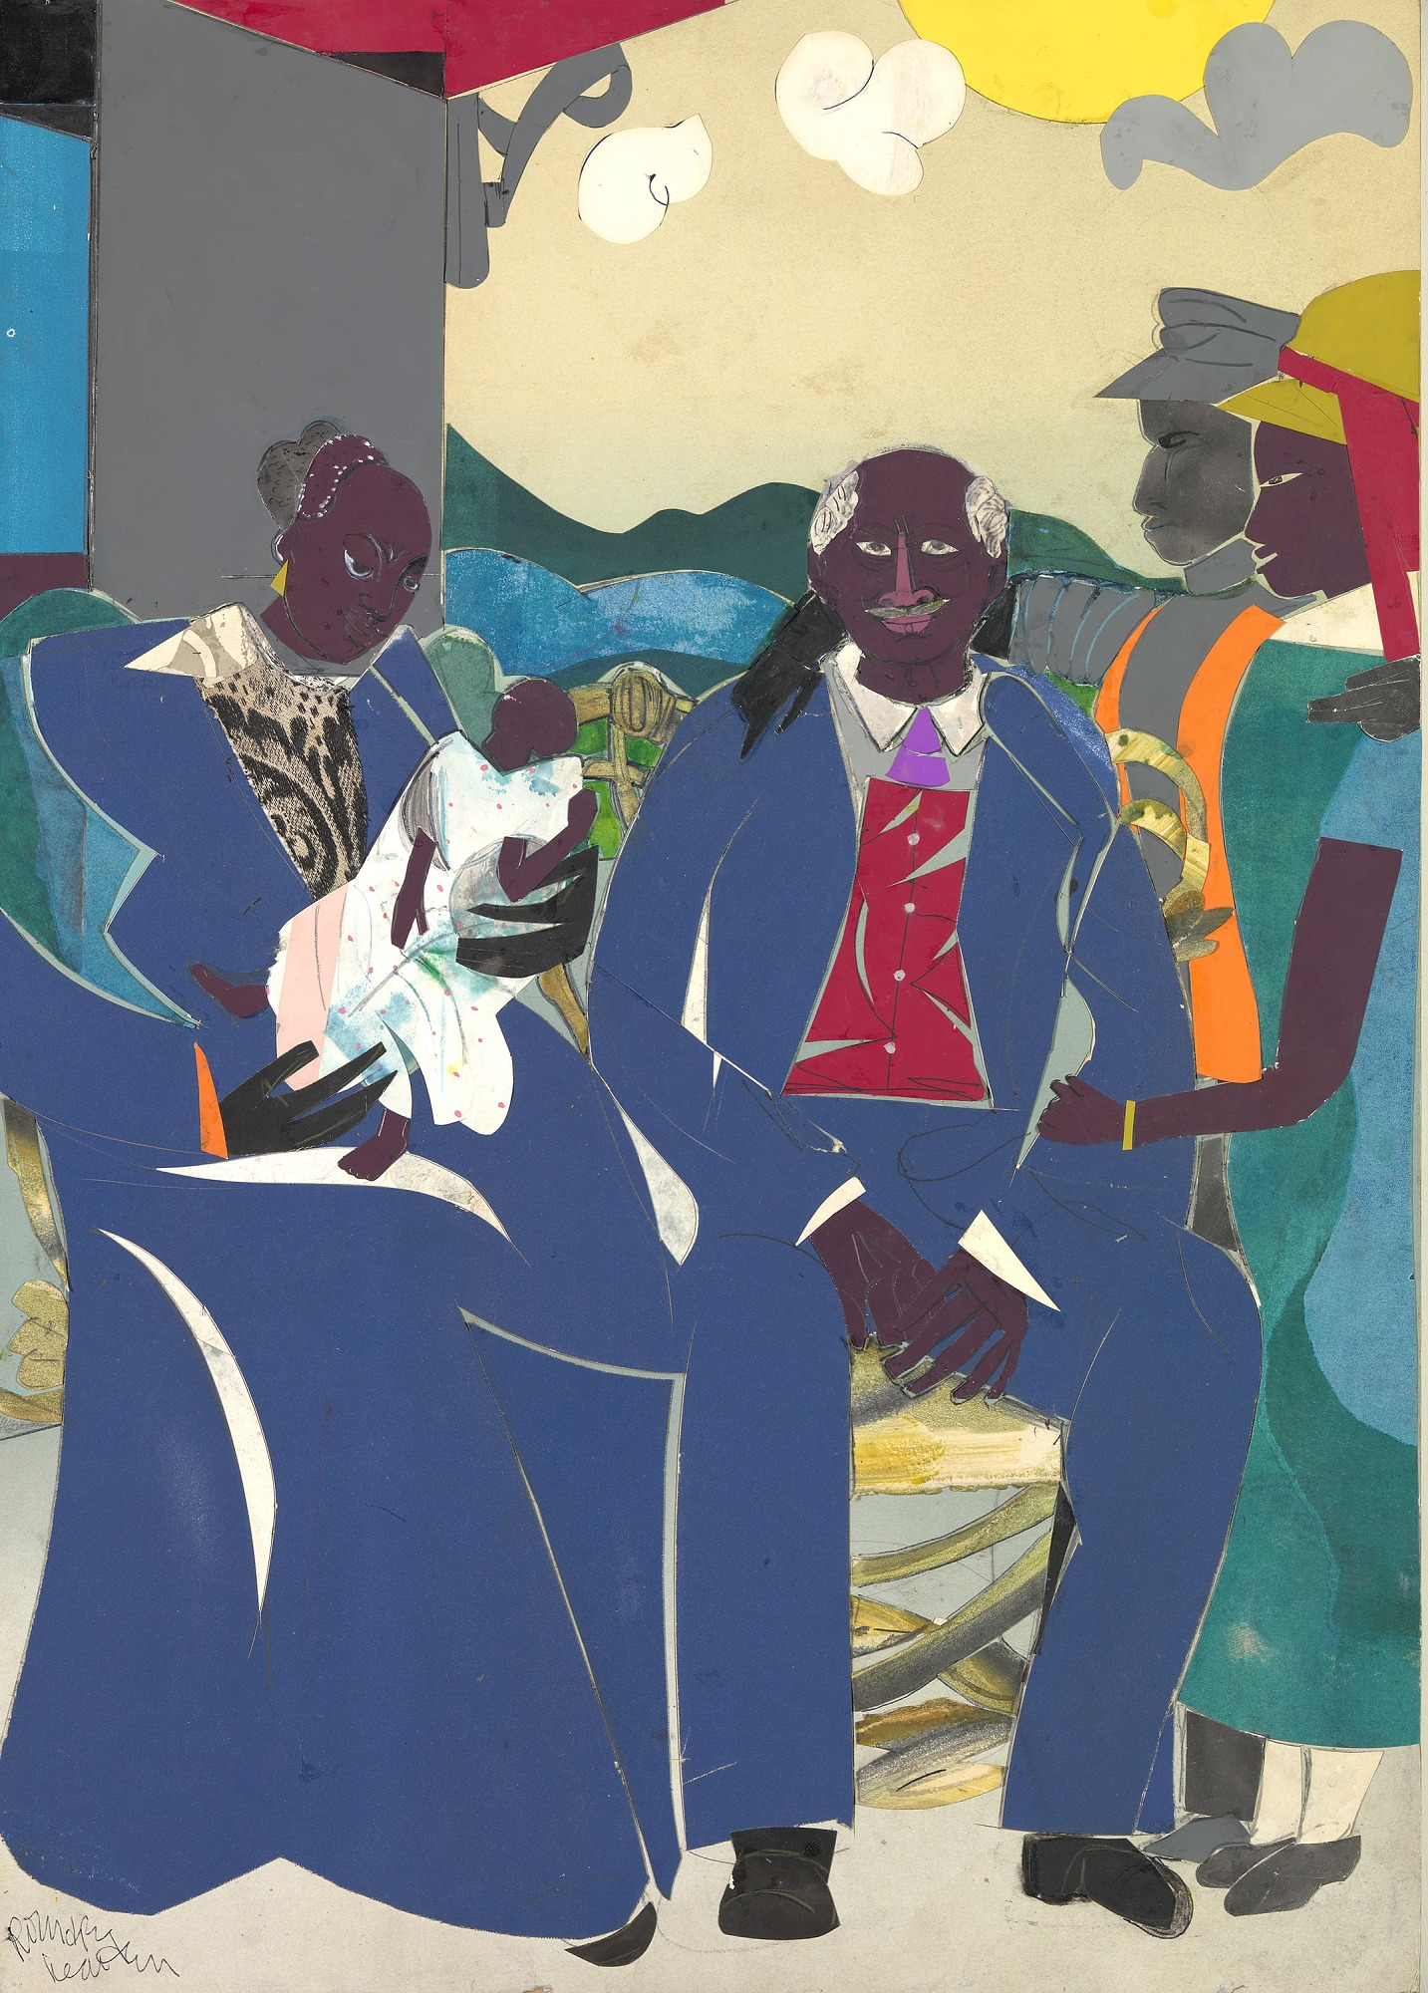
The Piano Lesson (1983), color lithograph.
Pennsylvania Academy of the Fine Arts
Family (1986), collage on wood. Smithsonian American Art Museum

Slide 9
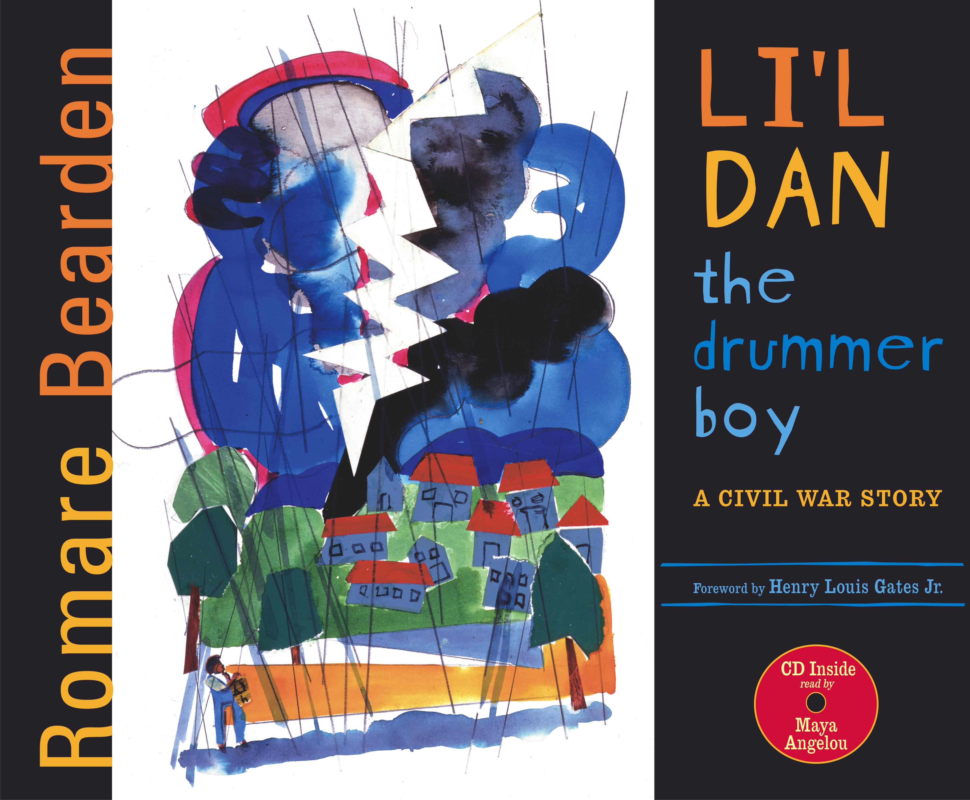
Li’L Dan the Drummer Boy
Recently, a book written and illustrated by Romare Bearden was discovered.
It is a sweet story about a little musician boy who saves his new soldier friends during the Civil War.
The published version includes a reading by Maya Angelou, an accomplished and well-respected African American poet and author.
Maya Angelou taught at Wake Forest University in Winston-Salem, North Carolina until 2011. She passed away in 2014.

Slide 10
Enjoy the story
Link to the video Li'l Dan The Drummer Boy
https://www.youtube.com/watch?v=yr8NNaHLlUA

Slide 11
Further explorations
Can you find something to use as a drum? A bucket or a cooking pot or a box or a can would all work. See if you can imitate the sounds you hear around you, like Dan does.
Which army in the Civil War wore blue uniforms? Which army wore gray uniforms?
The soldier in blue tells Dan he’s free and can go anywhere he wants. Where would you go if you could go anywhere you want?
What is a MASCOT? What does it mean that Dan is the mascot for Company E?
General Sherman invites Li’l Dan to join the Army Drum Corps. Why do you think music and drums were important to soldiers fighting in the Civil War? Why might music have been important to slaves on the plantations?

Slide 12
Want to Learn more about Romare BearDEN?
The Art of Romare Bearden: A Resource for Teachers by the National Gallery of Art, Washington.
Romare Bearden Foundation
Come Look with Me: Discovering African American Art for Children
by James Haywood Rolling Jr.
Available at the www.gofollett.com digital library GCS students can access for free.

Slide 13
This presentation was prepared by Cindy Reid & Annika Pfaender Arts Integration Facilitators GCS Arts Integration Academy
April 9, 2020

