Slide 1
The Gee’s bend quiltmakers
PREPARE TO BE AMAZED!

Slide 2
Gee’s bend quiltmakers
Gee’s Bend is a small rural community in Alabama
They are known for making hundreds of complex and colorful quilts
These quilts are an integral part of African American art in this community

Slide 3
Different types of Gee’s Bend Quilts
Notice geometric shapes in irregular forms tion

Slide 4
Abstraction & Improvisation
“My way” quilts ☺
They don’t follow the norms of traditional folk art
They start with basic forms and give each quilt unique flair
See unexpected patterns, unusual colors, surprising rhythms

Slide 5
“Housetop & Bricklayer”
These quilts are known for their concentric squares
They contain right angles
They begin with a piece of solid cloth
Notice that rectangular pieces of cloth create a “frame” around the center
Larger frames and borders are added until a block is complete

Slide 6
Patterns and Geometry
Created with single repeating patches
Uses shapes such as triangles, squares, diamonds, and hexagons to describe life in ”the Bend”
These gave the quiltmakers a way to provide home insulation for cold nights
Quilts that contain a single shape repeat, revise and rearrange themselves in different variations

Slide 7
WORN-OUT Work Clothes
These were born from the scarcity of cloth
They used salvaged fabric scraps and remnants
Until the mid-twentieth century, these quilts were made from worn-out work clothes such as aprons, overalls, & dress bottoms
This practice carried through many generations of quiltmakers
They knew the stains, tears, and fading on the material had a story to tell

Slide 8
Now watch this great video!

Slide 9
Please look for these answers as you watch, then answer when you finish!
1. What do the quilters also do while they are sewing? (The video shows four other things they are possibly doing while they are stitching!)
2. Why do the women work as a group on the same quilt?
3. What do you think the woman meant when she said she always liked to look out of windows?
4. Why did the slaves’ cook not have to walk while on their journey?
5. Why did the people in this community start making quilts in the first place?
6. What do you think is the reason that a printmaker made paper prints (copies) of the quilts?

Slide 10
EXAMPLES OF Two dimensional shapes
Triangle
Square
Rhombus
Rectangle
Parallelogram
Trapezoid

Slide 11
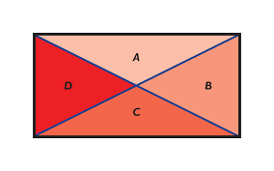
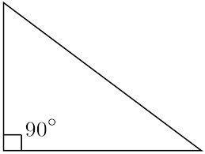
Triangle
Is a closed shape with three straight sides.
Is an example of a polygon
Has three angles

Slide 12
Square
Has four equal sides
Has four right angles
Is an example of a quadrilateral

Slide 13
Rhombus
Has four sides
Is a quadrilateral
Is a “slanting square”
The opposite inside angles are equal
The opposite sides are parallel

Slide 14
Rectangle
Has four sides and four corners
The sides meet at four right angles
Is a quadrilateral
Is also a parallelogram !
What do you notice about the quilt that is pictured? Does it have perfect rectangles?? Why or why not?

Slide 15
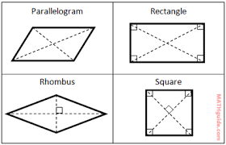
Parallelograms
Are quadrilaterals
Have two pairs of parallel sides
Have four edges
Opposite sides are the same length

Slide 16
Trapezoid
Is a flat closed shape
Has four straight sides
Has only one pair of parallel sides
Is an example of a parallelogram

Slide 17
Your turn!
Choose a style of quilt:
Abstraction & Improvisation
“Housetop & Bricklayer”
Patterns & Geometry
Work Clothes
Choose at least 2 geometric shapes to feature in your quilt within the traditional characteristics
Draw out your new Gee’s Bend style quilt on practice paper with just a pencil at first- - to get your design the way you like it
Then transfer your design to a sturdy piece of clean paper and use a ruler to create straight edges
Make sure to write at the bottom of your paper what shapes and quilt type you used
Think & practice ahead with which colors look good together, and carefully color in the sections

Slide 18
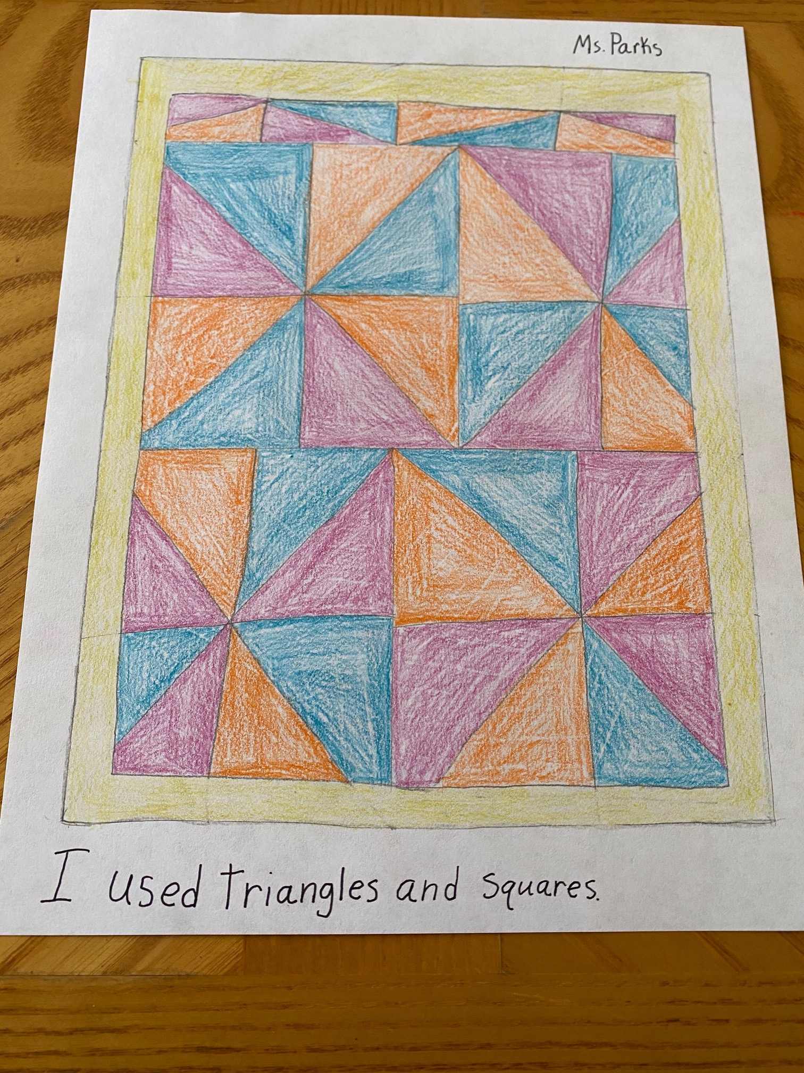
For example
Here is an example of a Patterns & Geometry quilt
This uses squares and triangles
How many squares do you see?
How many triangles are inside the squares?

Slide 19
Standards
NC.3.G.1-Reason with two-dimensional shapes and their attributes
Recognize and draw examples and non-examples of types of quadrilaterals including rhombuses, rectangles, squares, parallelograms, and trapezoids
Also…..NC.4.G.2 Classify quadrilaterals and triangles based on angle measure, side lengths, and the presence or absence of parallel or perpendicular lines.
3.V.1.2- Understand that artists use their art to express personal ideas
3.V.2.3- Create art from realistic sources of inspiration 3.VA.CX.1.1 - Exemplify how visual arts are used by various groups for artistic expression within the local community.
3.VA.CX.1.2 - Understand how art documents the history of the local community.

Slide 20
Sources
https://www.soulsgrowndeep.org/gees-bend-quiltmakers
https://www.splashlearn.com/math-vocabulary/geometry/triangle
https://www.splashlearn.com/math-vocabulary/geometry/square
https://study.com/academy/lesson/rhombus-lesson-for-kids-definition-facts.html
https://www.splashlearn.com/math-vocabulary/geometry/rectangle
https://kids.kiddle.co/Parallelogram
https://www.splashlearn.com/math-vocabulary/geometry/trapezoid

